Slide 1
Modular Programming with Functions

Slide 2
Modularity
How do you solve a big complex problem ?
Divide it into small tasks
Solve each task.
Then combine these solutions.

Slide 3
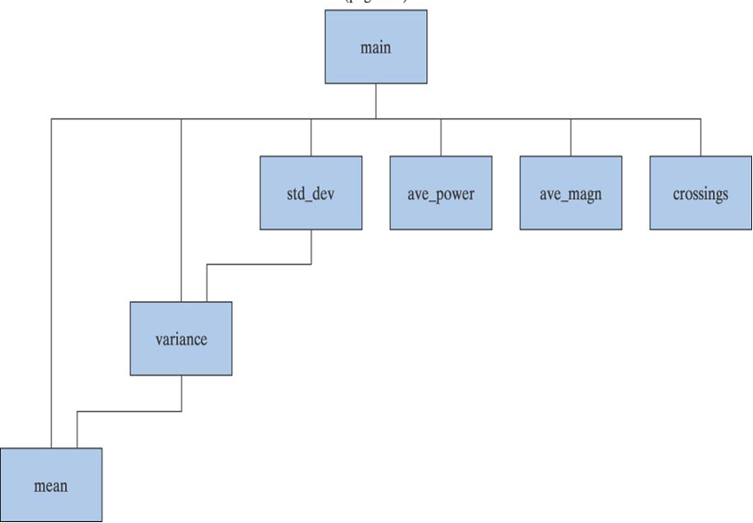
Modularity…
In C we use functions also referred to as modules to perform specific tasks that we determined in our solution

Slide 4
Advantages of using Modules
Modules can be written and tested separately
Modules can be reused
Large projects can be developed in parallel
Reduces length of program, making it more readable
Promotes the concept of abstraction
A module hides details of a task
We just need to know what this module does
We don’t need to know how it does it

Slide 5
Types of functions
Functions
Pre-defined library functions
e.g. printf, scanf
Programmer defined functions

Slide 6
Elements of user defined functions
Being derived data types, there is much similarity between functions and variables.
Functions also have data types associated with them.
Functions names and their types must be declared and defined before they are used in the program.

Slide 7
Elements of user defined functions
In order to make use of user defined function, three elements are necessary:
1.Function definition
2. Function call
3. Function declaration

Slide 8
#include<stdio.h>
// function prototype, also called function declaration
int square ( int x );
// main function, program starts from here
main( )
{
int m, n ;
printf ( "\nEnter some number for finding square \n");
scanf ( "%d", &m ) ;
n = square ( m ) ; // function call
printf ( "\nSquare of the given number %f is %d",m, n );
}
int square ( int x ) // function definition
{
int p ;
p = x * x ;
return ( p ) ;
}
Notes:
A function prototype is simply the declaration of a function that specifies function's name, parameters and return type. It doesn't contain function body. A function prototype gives information to the compiler that the function may later be used in the program.

Slide 9
Function Definition
return_type function_name (parameters)
{
declarations;
statements;
}
int my_add_func(int a, int b)
{
int sum;
sum = a + b;
return sum;
}

Slide 10
Function Body
3 parts:
Declarations
Function statements
Return statement
Examples:
float mul(float x,float y)
{
float result; //local variable
result=x*y; //computation
return(result); //returns float value
}

Slide 11
Function Body
Void sum(int a, int b)
{ //no local variable
printf(“sum=%s”, a+b); // computation
}
Void display(void)
{ //no local variable
printf(“no type,no parameters”);
} // return statement

Slide 12
Return values and their types
return statement can take one of the following forms:
return; OR
return(expression);
Example:
return;
return(p);
return(x*y);

Slide 13
Function call
A function can be simple called using function name followed by a list of actual parameters:
main()
{ int y;
y=mul(10,5);
printf(“%d”,y);
}
int mul(int x,int y)
{
int p;
p=x*y; /* x=10, y=5 */
return(p);
}

Slide 14
Function call
Different ways of calling a function:
mul(10,5)
mul(m,5)
mul(10,n)
mul(m,n)
mul(m + 5,10)
mul(10, mul(m,n) )
mul(expression1, expression2)

Slide 15
Function call
The actual parameters must match the function’s formal parameters in type, order and number.

Slide 16
Function declaration
4 parts:
Function type (return type)
Function name
Parameter list
Terminating semi colon
Function-type function-name(parameter list);
int multiplication ( int m, int n);
int multiplication ( int, int)
multiplication ( int, int)
Notes:
int

Slide 17
Function declaration
Note :
The parameter list must be separated by commas.
Parameters in declaration must match the types of parameters in function definition, in number and order.
Use of parameter names in declaration is optional.
If function has no formal parameters, the list is written as (void).

Slide 18
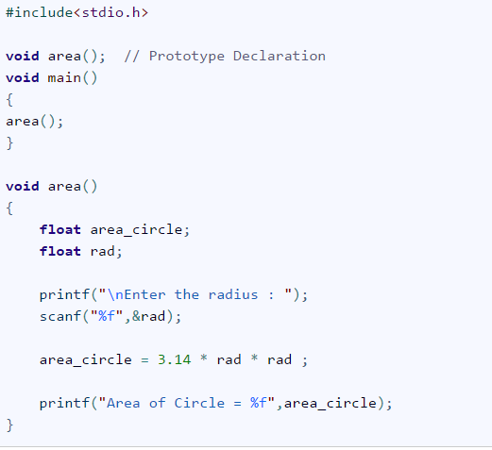
No arguments and no return values

Slide 19
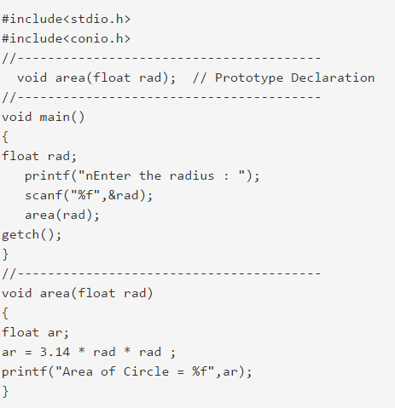
Arguments with no return values

Slide 20
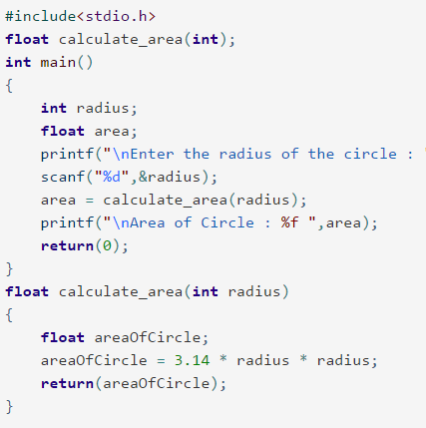
Arguments with return values

Slide 21
Exercise: void functions
Write a program to generate the following output?
#include <stdio.h>
void print_i_star(int i);
main()
{
int i;
for (i=1; i<=5; i++) {
print_i_star( i );
}
}
void print_i_star(int i)
{
int j;
for (j=1; j<=i; j++)
printf(“*”);
printf(“\n”);
return;
}
*
**
***
****
*****
for (i=1; i<=5; i++) {
for (j=1; j<=i; j++)
printf(“*”);
printf(“\n”);
}

Slide 22
Exercise
Write a function to compute maximum and minimum of two numbers
int max(int a, int b)
{
if (a > b)
return a;
else
return b;
}
int min(int a, int b)
{
if (a < b)
return a;
else
return b;
}

Slide 23
Exercise
Write a function that takes score as parameter and computes and returns letter grade based on the scale below.
80-100 A
60-79 B
40-59 C
0-39 D

Slide 24
Solution
char get_letter_grade(int score)
{
char grade;
if ((score >= 80) && (score <=100))
grade = 'A';
else if ((score >= 60) && (score <= 79))
grade = 'B';
else if ((score >= 40) && (score <= 59))
grade = 'C';
else if ((score >= 0) && (score <= 39))
grade = 'D';
return grade;
}

Slide 25
Exercise
What is the output of the following program
#include <stdio.h>
int function1(int x)
{
x = 2;
printf("Out1 = %d\n",x);
return(x+1);
}
int main()
{
int x = 4, y;
y = function1(x);
printf("Out2 = %d\n",x);
printf("Out3 = %d\n",y);
return 0;
}

Slide 26
Exercise
What is the output of the following program
#include <stdio.h>
int function1(int x)
{
x = 2;
printf("Out1 = %d\n",x);
return(x+1);
}
int main()
{
int x = 4, y;
y = function1(x);
printf("Out2 = %d\n",x);
printf("Out3 = %d\n",y);
return 0;
}
Output
Out1 = 2
Out2 = 4
Out3 = 3

Slide 27
Exercise
What is the output of the following program
#include <stdio.h>
void function2()
{
printf("In function 2\n");
}
void function1()
{
function2();
printf("In function 1\n");
}
void function3()
{
printf("In function 3\n");
function2();
}
int main()
{
function1();
function3();
return 0;
}

Slide 28
Exercise
What is the output of the following program
#include <stdio.h>
void function2()
{
printf("In function 2\n");
}
void function1()
{
function2();
printf("In function 1\n");
}
void function3()
{
printf("In function 3\n");
function2();
}
int main()
{
function1();
function3();
return 0;
}
Output
In function 2
In function 1
In function 3
In function 2

Slide 29
Recursion
Recursion is a process where a function calls itself.
main()
{
printf(“ recursion example”);
main();
}

Slide 30
factorial(int); //declaration
Void main()
{
printf(“answer is %d”, factorial(5)); //call
}
factorial(int n) //definition
{
int fact;
if(n==1)
return(1);
else
fact= n * factorial(n-1);
return(fact);
}

Slide 31
Passing arrays to functions
To pass a one dimensional array to a function, it is sufficient to list the name of array, without any subscript and the size of array as arguments. For example,
largest(a,n) //function call
The called function should be defined as:
float largest(float array[ ], int size) //definition
It is not necessary to specify the size of array here.

Slide 32
Program to find largest value
float largest(float a[ ], int n);
main()
{
float value[4]= {2.5, -4.75, 1.2,6.0};
printf(“ %f ”, largest(value, 4));
}
float largest(float a[ ], int n)
{
int i;
float max;
max= a[0];
for(i=1; i<n ; i++)
if(max< a[i])
max= a[i];
return(max);
}

Slide 33
Program to sort array elements
void sort(int m, int x[ ]);
main()
{
int i;
int marks[5] = {40, 90, 73, 81, 35}; printf("Marks before sorting\n");
for(i = 0; i < 5; i++)
printf("%d ", marks[i]); sort (5, marks);
printf("Marks after sorting\n");
for(i = 0; i < 5; i++)
printf("%d", marks[i]);
}

Slide 34
Program to sort array elements
void sort(int m, int x[ ])
{
int i, j, t; for(i = 0; i < m; i++)
for(j = i+1; j < m; j++)
if(x[i] >= x[j])
{
t = x[i]; x[i] = x[j]; x[j] = t;
}
}

Slide 35
Passing string to functions
String to be passed must be declared as a formal argument of the function when it is defined.
void display( char item_name[ ])
Declaration must show that the argument is string.
void display(char str[ ]);
A call to the function must have a string array name without subscripts as its actual parameters.
display(names);

Slide 36
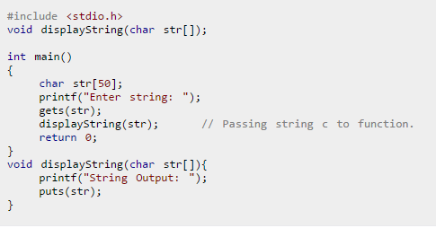
Passing string to functions

Slide 37
Parameter passing
Call by value
formal parameter receives the value of the actual parameter
function can NOT change the value of the actual parameter
Call by reference
actual parameters are pointers
function can change the value of the actual parameter

Slide 38
Scope of a variable
Local scope
a local variable is defined within a function or a block and can be accessed only within the function or block that defines it
Global scope
a global variable is defined outside the main function and can be accessed by any function within the program file.

Slide 39
Scope of a variable
When you declare a variable, that name and value is only “alive” for some parts of the program
We must declare variables before we use them, so the scope of a variable starts when it is declared
If the variable is declared within a block, it only stays alive until the end of the block
If the block is the one surrounding the entire function body, the variable is alive from where it is declared until the end of the function
If the block defines a loop body or if-statement body, the variable only lives till the end of loop

Slide 40
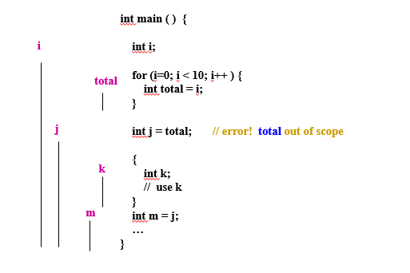

Slide 41
Storage classes- four types
Storage class refers to the lifetime of a variable
automatic - key word auto - default for local variables
Memory set aside for local variables is not reserved when the block in which the local variable was defined is exited.
external - key word extern - used for global variables
Memory is reserved for a global variable throughout the execution life of the program.
static - key word static
Requests that memory for a local variable be reserved throughout the execution life of the program. The static storage class does not affect the scope of the variable.
register - key word register
Requests that a variable should be placed in a high speed memory register.

Slide 42
How to return an array from a function? C programming does not allow to return an entire array as an argument to a function. However, you can return a pointer to an array by specifying the array's name without an index. If you want to return a single-dimension array from a function, you would have to declare a function returning a pointer
#include <stdio.h>
int *getarray()
{
int arr[5];
printf("Enter the elements in an array : ");
for(int i=0;i<5;i++)
{
scanf("%d", &arr[i]);
}
return arr;
}
int main()
{
int *n;
n=getarray();
printf("\nElements of array are :");
for(int i=0;i<5;i++)
{
printf("%d", n[i]);
}
return 0;
}

